Slide 1
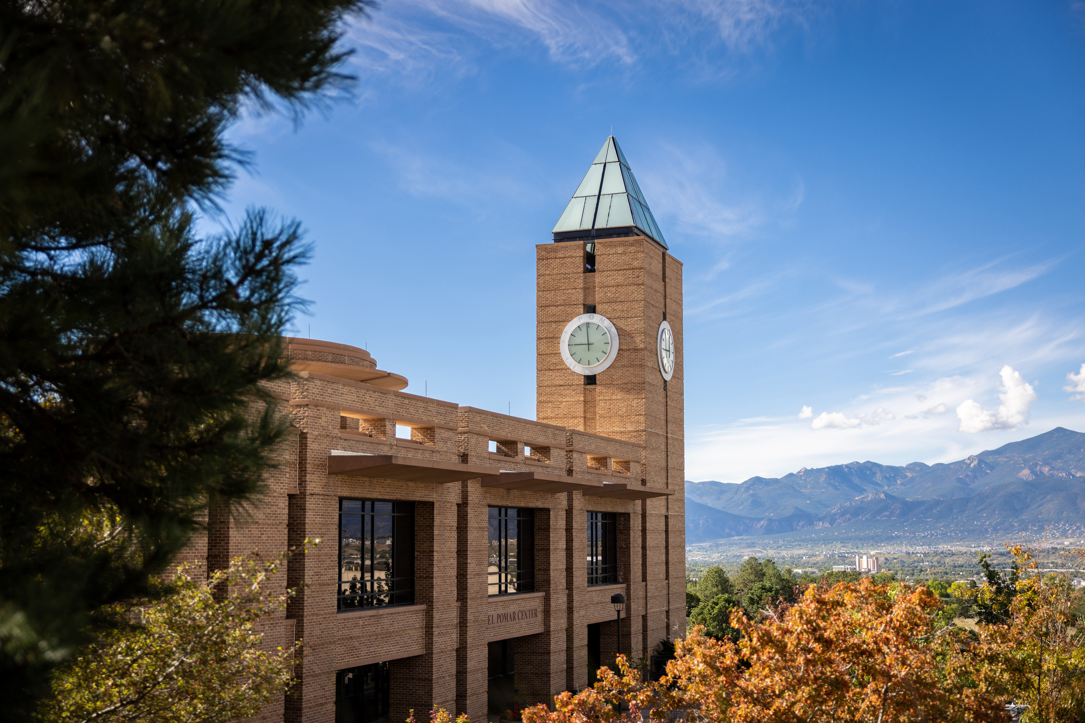


LAS 2026
OUTSTANDING FACULTY AND STUDENT AWARDS

Slide 2

FACULTY AWARDS
  Creative Works
  Research
  Teaching

Slide 3

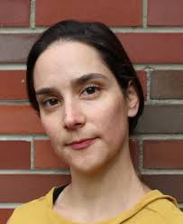
OUTSTANDING CREATIVE WORKS AWARD
Rosely Conz, M.F.A.
Assistant Professor of Dance
Visual and Performing Arts

Slide 4
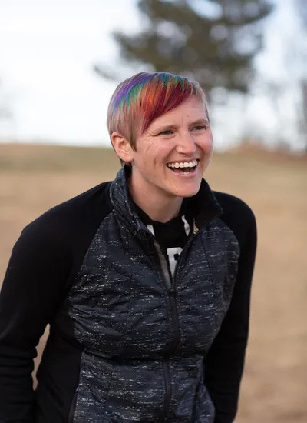
OUTSTANDING RESEARCH AWARD
Dr. Jennifer Kling
Associate Professor and Chair Philosophy

Slide 5
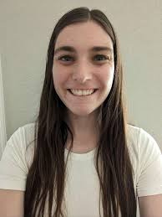
OUTSTANDING TEACHING GRADUATE TEACHING CATEGORY
Ariel Russell
PhD Student and
Graduate Teaching Fellow
Mathematics

Slide 6
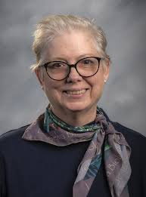
OUTSTANDING TEACHING TEACHING PROFESSOR CATEGORY
Dr. Susan Howell
Assistant Teaching Professor Anthropology

Slide 7
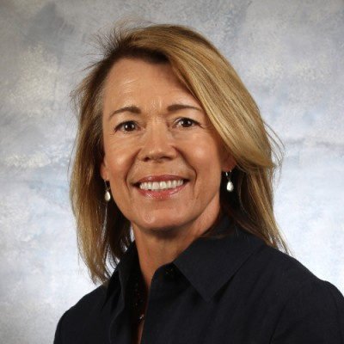
OUTSTANDING TEACHING ONLINE CATEGORY
Dr. Janice Thorpe
Teaching Professor / Director, COMM Online/Internships Communication

Slide 8
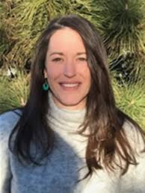
OUTSTANDING TEACHING TENURE TRACK CATEGORY
Dr. Rebecca Greene
Assistant Professor
Anthropology

Slide 9
PROGRAM AWARDS
Outstanding Students

Slide 10
INTERDISCIPLINARY STUDIES
Christina Wolfe
INDS Outstanding Student

Slide 11
MILITARY SCIENCE
Destan Martin
LAS Top Graduating Senior
Jonathan Petak
LAS ROTC Scholarship

Slide 12
DEPARTMENTAL AWARDS
Outstanding Students

Slide 13
ANTHROPOLOGY
Jocelyn Dominguez
Outstanding Student
Gillian Donnelly
Linguistic Anthropology
Jillian Gordon
Cultural Anthropology
Ella Love
Museum Studies
Ava Neuharth
Archaeology,
Biological Anthropology,
Leadership-Peak Ambassador
Brendan O'Dell
Museum Practice &
Heritage Management - B.I.

Slide 14
BIOLOGY
OUTSTANDING STUDENTS
Tammara Davis
Outstanding B.S.
Nylah Mirshafiei
Outstanding B.S.
Samantha Perry
Outstanding B.S.
Brooke Peterson
Outstanding B.S.
Jennifer Soloc
Outstanding B.S.

Slide 15
CHEMISTRY/BIOCHEM
OUTSTANDING STUDENTS
Lily Lyons
Biochemistry, BS
Nathan Maruska
Chemistry, BS
James Mulcahey
Chemistry, BS
Luna Park
Biochemistry, BS
Kevin Schroeder
Biochemistry, BS

Slide 16
COMMUNICATION
OUTSTANDING STUDENTS
Caedmon Denmark
Professional Communication
Joseph Impellitteri
Digital Filmmaking and Media
Kadence Kubish
Online Program
Bennett Mallot
Graduate Student
Sydnee-Anne Moeller
General Communication
Anna Poe
Sports Comm
Elisabeth Stretch
Media Studies

Slide 17
ECONOMICS
OUTSTANDING STUDENTS
Ismail Garcia
Franka Endowed Fund for Economics Scholarship
Addison Hickman
Undergraduate Student

Slide 18
ENGLISH
OUTSTANDING STUDENTS
Natalie Burton
Literature emphasis
Mackenna Elliott
Literature emphasis
Sophia Kustar
Literature emphasis
Bethany Odegard
Literature emphasis
Tessa Schauer
Literature emphasis

Slide 19
ENGLISH
OUTSTANDING STUDENTS
Tanner Bertram
Rhetoric & Writing emphasis
Ava Cooreman
Rhetoric & Writing emphasis
Gianelly Ayala Rodriguez
Rhetoric & Writing emphasis
Rin Westbay
Rhetoric & Writing emphasis
Olivia Yocum
Rhetoric & Writing emphasis

Slide 20
ENGLISH
OUTSTANDING STUDENTS
Shawn Bakker
English Studies Online (ESO) emphasis
Lillian Hyatt
Secondary English Education emphasis
Sophia Kustar
English Outstanding Leadership
Isaac Dumas
Leadership-LAS Peak Ambassador
Tessa Schauer
Leadership-LAS Peak Ambassador

Slide 21
GES
OUTSTANDING STUDENTS
Brendan Malloy
GES
Paulina Oakland
GES
Campbell Curcio
Geology Minor
Chase Ingersoll
GIScience
Houston Jones
GIScience
Lindsay Polaski
GIScience

Slide 22
GES
OUTSTANDING STUDENTS
Peter Harrison
Conservation, Parks, and Outdoor Recreation Minor
Emery Grey
Most Interdisciplinary
Noemi Rives
Most Interdisciplinary
Campbell Curcio
GES Leadership
Paulina Oakland
Graduate Fellowship for Excellence in Research
Faraday Abplanalp
Undergraduate Research

Slide 23
GES
OUTSTANDING STUDENTS
Melissa Butch
Jacqueline Beyer Fellowship
Marie Dahlberg
Jacqueline Beyer Fellowship
Gabby Lail
Jacqueline Beyer Fellowship
Grace Long
Jacqueline Beyer Fellowship

Slide 24
HISTORY
OUTSTANDING STUDENTS
Jack Elbert
Undergraduate
Hazel Kartye
Undergraduate
Kendal Johanna Liden
Undergraduate
Raven Leah Wilcox
Undergraduate

Slide 25
HISTORY
OUTSTANDING STUDENTS
Laura Fadley
Graduate
Dom Markham
Graduate
Ryan Wilkinson
Graduate
Paul Zuluaga
Graduate
Laura Fadley
Leadership-LAS Peak Ambassador

Slide 26
LANG. & CULT.
OUTSTANDING STUDENTS
Kelsey Bell
American Sign Language
Steffany Hernandez
American Sign Language
Precious Holland
American Sign Language
Emma Lepine
American Sign Language
Sarah Lochridge
American Sign Language
Sydney McDaniel
American Sign Language
Syndee-Anne Moeller
American Sign Language

Slide 27
LANG. & CULT.
OUTSTANDING STUDENTS
Henry Cummings
French Minor in STEM
Yolanda Ofori
French Minor in STEM
Rin Westbay
French Minor
Joshua Billeg
German Minor
Bradyn Groat
Japanese Minor
Catalina Arreola-Ramirez
Spanish
Ytzel Lugo
Spanish
Erik Saldaña
Spanish

Slide 28
MATH
OUTSTANDING STUDENTS
Aaron Anderson
B.S. Math
Kaya Pillivant
B.S. Math
Kayla Swanson
B.S. Math
Zacchaea Underwood
B.S. Math
Jonas Graff
Robert S. and Barbara R. Lorch Department of Mathematics Endowed Scholarship
Isabella Johnson
Robert S. and Barbara R. Lorch Department of Mathematics Endowed Scholarship

Slide 29
PHILOSOPHY
OUTSTANDING STUDENTS
Liliana Doskey
Undergraduate
Rebekah Nelson
Undergraduate
Taiya Werling
Philosophy Double Major
Zac Jolles
Asian Studies Minor
Hope Mansikka
Philosophy Minor
Ethan Vigil
Religious Studies Minor
Logan McVay
Eldon Stevens Outstanding Thesis Award

Slide 30
PHYSICS
OUTSTANDING STUDENTS
Fariya Methila
Undergraduate
Laurel Powell
Undergraduate
Grayson Sharp
Undergraduate
Varun Vanga
Undergraduate

Slide 31
PSYCHOLOGY
OUTSTANDING STUDENTS
Amy Benge
Undergraduate
Dakota Gonzalez
Undergraduate
Ashley Johnston
Undergraduate
Rosarita (Rita) Neal
Undergraduate

Slide 32
PSYCHOLOGY
OUTSTANDING STUDENTS
Grace "Gemma" Brom
MA Student in Clinical Psychology
Ayan "Yani" Yakob
MA Student in Psychological Science
Jonathan Sundby
PhD Student (Geropsychology)
Alex Stover
PhD Student
(Trauma)

Slide 33
POLITICAL SCIENCE
OUTSTANDING STUDENTS
Linnea Berb
Undergraduate

Slide 34
SOCIOLOGY
OUTSTANDING STUDENTS
Avery Buss
Undergaduate
Eila McMillin
Undergraduate
Joshua Page
Undergraduate

Slide 35
TCID
OUTSTANDING STUDENTS
Eden Love
Excellence Award
Tatiana Choate
Innovation Award
Joslyn Bayley
Leadership Award

Slide 36
VAPA
OUTSTANDING STUDENTS
Emily De Smidt
VAPA
Lila Pacheco
Art History
Katherine Monsen
Film Studies
Nikki Wright
Film Studies
Autumn Choate
Music
Kaya Cogger
Theatre
Riley Rhodes
Visual Art

Slide 37
WEST
OUTSTANDING STUDENTS
Allison Schell
Undergraduate
Uriko Stout
Undergraduate

